Slide 1

Leadership
Frederick Guild, Jr.

Slide 2
Personally
I have been known to be a leader my entire life. Though looking back now, I can honestly say I have been unaware of what it takes to be a leader. Just thought you could be yourself and everything falls into place
I choose leadership for it is a key factor in the world this day an age. So many people are lost and looking for something and do not know where to look

Slide 3
Philippians 2:3-8
3Do nothing out of selfish ambition or vain conceit, but in humility consider others better than yourselves. 4Each of you should look not only to your own interests, but also to the interests of others. 5Your attitude should be the same as that of Christ Jesus: 6Who, being in very nature God, did not consider equality with God something to be grasped, 7but made himself nothing, taking the very nature of a servant, being made in human likeness. 8And being found in appearance as a man, he humbled himself and became obedient to death-even death on a cross!
Notes:
Background of the topic Leadership has been around since the beginning of time
Reference Holy Bible

Slide 4
10 Parts of leadership
Ambition
Humility
Attitude
Self-Discipline
Passionate
Example
Good Follower
Server
Responsible

Slide 5
Ambition
Be ambitious
Energy is contagious if you have a strong desire to accomplish something. The power of that can spread

Slide 6
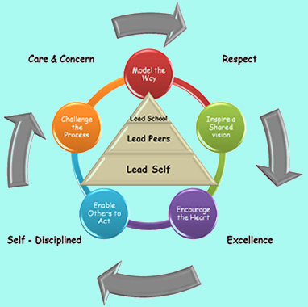
Self-Discipline
Self-discipline is a must.
Governing

Slide 7
Humility
As a leader you are expected to know everything. An some will wait until you don’t.
Be a expert of you.
Humility doesn’t mean you think of yourself less, just that you think of yourself less.
Notes:
You will not know everything there is to know. So you must be willing to accept that fact.

Slide 8

Attitude
Attitude determines altitude
Enthusiasm will go a long way

Slide 9
Example
John 13:12-15 12When he had finished washing their feet, he put on his clothes and returned to his place. "Do you understand what I have done for you?" he asked them. 13"You call me 'Teacher' and 'Lord,' and rightly so, for that is what I am. 14Now that I, your Lord and Teacher, have washed your feet, you also should wash one another's feet. 15I have set you an example that you should do as I have done for you.
Notes:
Leadership can’t be learned from a book as it in tales true application if you don’t go out and fail at something how can you instruct some on what not to do. If you do go and do application how can you tell someone what to do?

Slide 10
Good Follower
Every Great good leader has or was a good follower.
This doesn’t only apply to the healthcare field. A leader sees all opportunities for growth.

Slide 11
Serve
Leadership calls for servitude.
It is an obligation as a leader that you serve your internal customer needs as well as your external

Slide 12
Responsible
We are responsible for the lives of many Internal and External customers.
Your job affects the livily hood of all within your immediate range of business directly and indirectly

Slide 13
Summary
Why this topic is important in healthcare administration
Be anchored in truth. Let your passion be guided by truth.

Slide 14
Leadership
As administrators will be at the fore front of hundreds if not thousands of people internal and external customers
Leadership is of the upmost importance for people will do what you do you have to be the example you have to show you can get your elbows dirty, fight when needed, and comfort when the time comes

Slide 15
References
Holy Bible
Sadri, G. (2012). Emotional Intelligence and Leadership Development. Public Personnel Management, 41(3), 535-548.
Begun, J., White, K., & Mosser, G. (2011). Interprofessional care teams: the role of the healthcare administrator. Journal Of Interprofessional Care, 25(2), 119-123. doi:10.3109/13561820.2010.504135

